Slide 1


External Calibrator for Hydrogen Observatories
Michael Horn
Mentor: Dr. Danny Jacobs
NASA Space Grant Symposium
April 14, 2018

Slide 2
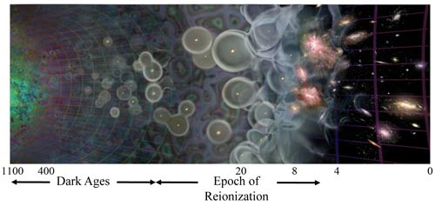
Overview
ECHO is a drone-mounted calibrator for radio telescopes
Radio telescopes are being used to study the early universe
Typically, telescopes use known sources in space for calibration (Sun, nearby stars)
ECHO provides a calibration system under full experimental control

Slide 3
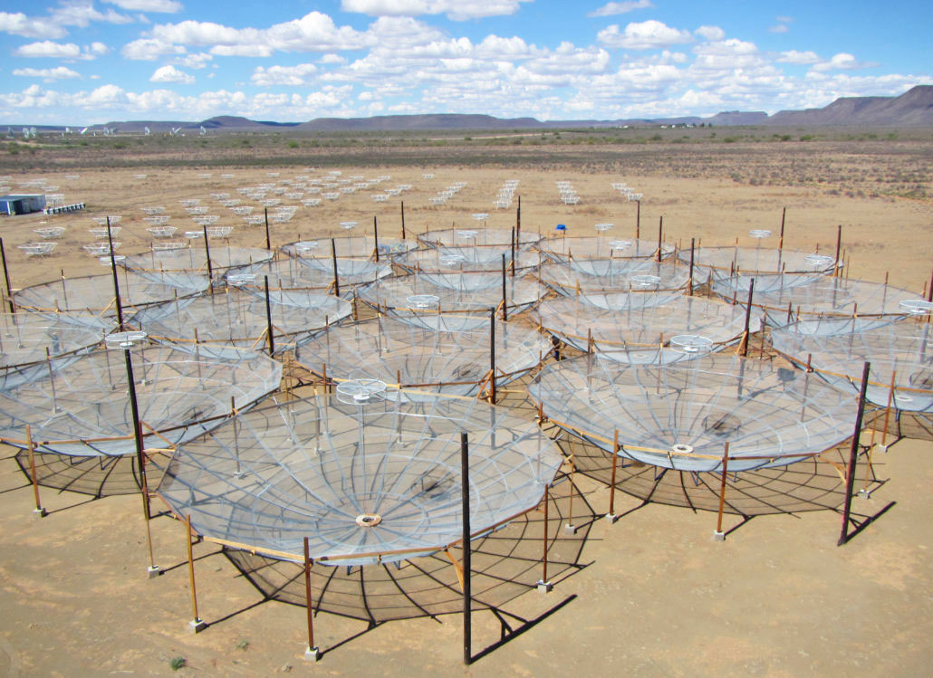
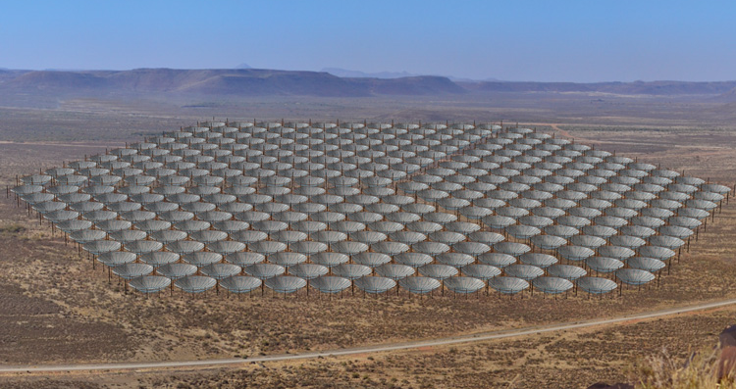
HERA
Hydrogen Epoch of Reionization Array
350-dish array
Each dish is 14m across and 6m tall
Based in Karoo, South Africa
Studies the early formation of stars and galaxies through Hydrogen emission
Still being built, currently up to 65 dishes
Layout designed for optimal resolution and high sensitivity

Slide 4
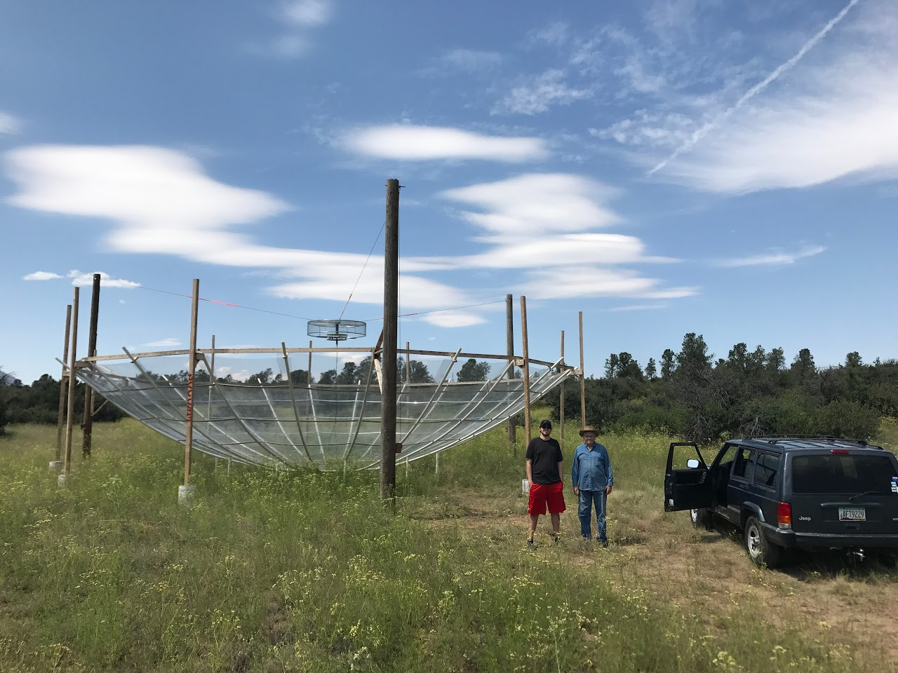
Prescott Test Dish
Exact replica of one HERA dish
Located right on Embry-Riddle Aeronautical University’s campus in Prescott, AZ
Built by students from ASU and ERAU
Local testing dish for ECHO
Made out of common materials
Currently developing a software defined radio to examine the spectrum response

Slide 5
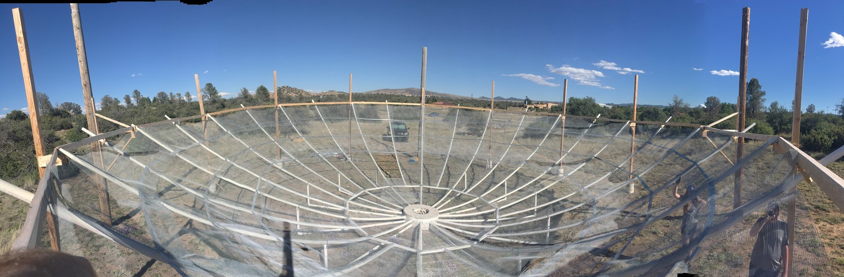
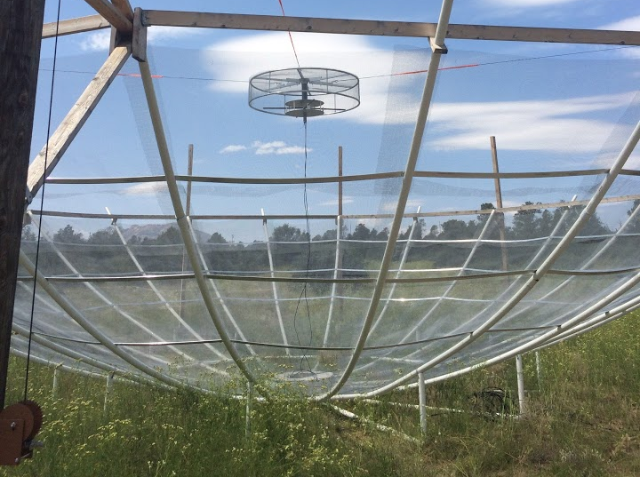

Slide 6
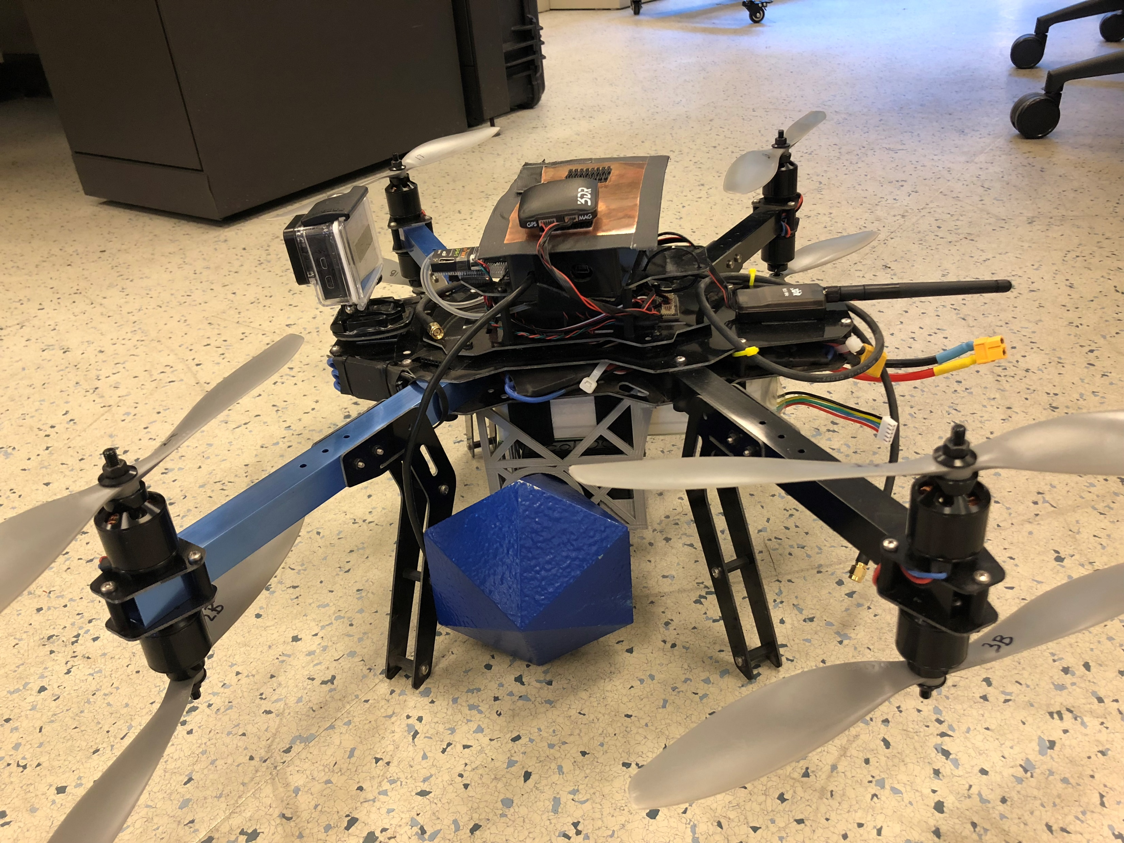
ECHO X8
ECHO v2 used a 3D Robotics X8 octocopter
11” propellers
4S 25C 10,000mAH battery
15 minute flight-time
Pixhawk autopilot for waypoint-based flight to follow a set path
GPS, communications radios, and ECHO blackbox (digital oscillator)
BicoLOG antenna outputs signal

Slide 7
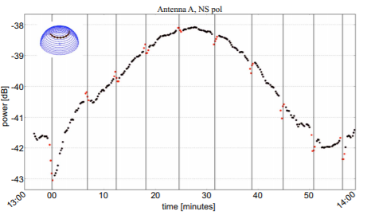
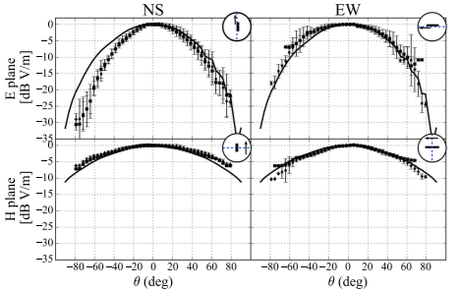
ECHO X8 Results
Tested at National Radio Astronomy Observatory in Green Bank, WV
Results mostly match the expected beam patterns as measured by another system (ORBCOMM) and simulations
Drone wiggled as it passed through through waypoints (top figure)
Flexible antenna mount caused about 10° undesired tilt (top left panel, bottom figure)
Goal to reduce unwanted movement and increase flight time

Slide 8
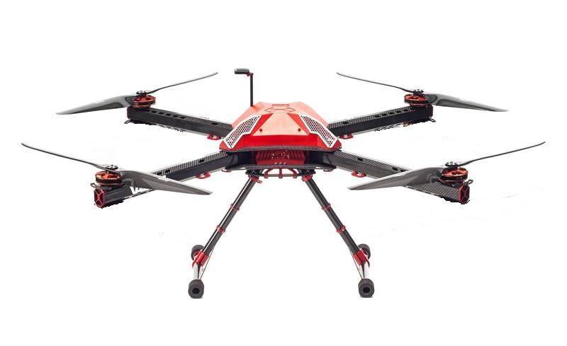
ECHO Vader
ECHO v3 will utilize a SteadiDrone Vader octocopter
28” propellers
5S 40C 10,000mAH batteries (4)
30+ minute flight-time
Pixhawk autopilot
First flights this summer!

Slide 9
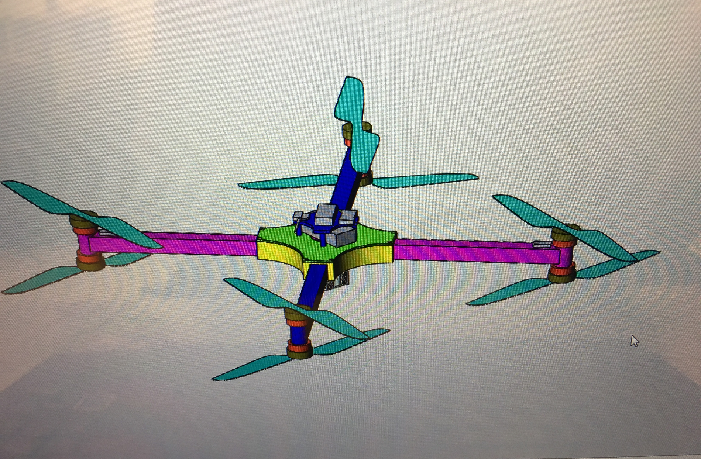
ECHO Chiropter
Custom designed drone for ECHO
Current plans attempt to mimic key Vader design choices
  Similar propellers, motors, batteries
Accessible mounting area for transmitter
Focus on minimizing cost to produce while upholding quality
Currently in the design phase
  Selecting components
  3D modeling

Slide 10
Acknowledgements
I would like to thank the following people for their help and support throughout this project:
Dr. Danny Jacobs
ASU/NASA Space Grant
Members of ECHO past and present
Prescott Test Dish team and ERAU
Low-Frequency Cosmology Lab (LoCo) at ASU
None of this would have been possible without each of your individual contributions!

Slide 11
Questions?

